Slide 1
Broadcast Technology
From SDI to IP workflows;
and from DAB to DASH distribution
Jerry Foss
jeremy.foss2@bcu.ac.uk

Slide 2
This Session …
Production
Distribution
(Analogue/historical)
Analogue Terrestrial,
…. Cable TV,
…. CATV (community antenna (US))
…. Satellite
Digital
SDI Workflows
(inc NDI)
(Web, downloads, etc)
Digital
DVB –
Terrestrial – DVB-T / T2
Cable TV – DVB-C / C2
Satellite – DVB-S / S2
Telco Broadband
– DVB-I (IPTV)
DAB Radio
Web
http (HLS, DASH)
inc mobile 5G, 6G, etc
IP Workflows
SMPTE 2022 SMPTE 2110
PTP
5G, 6G,
etc
This lecture will address the red topics as an introduction and in a context in this evolution of the broadcast industry.

Slide 3


Slide 4
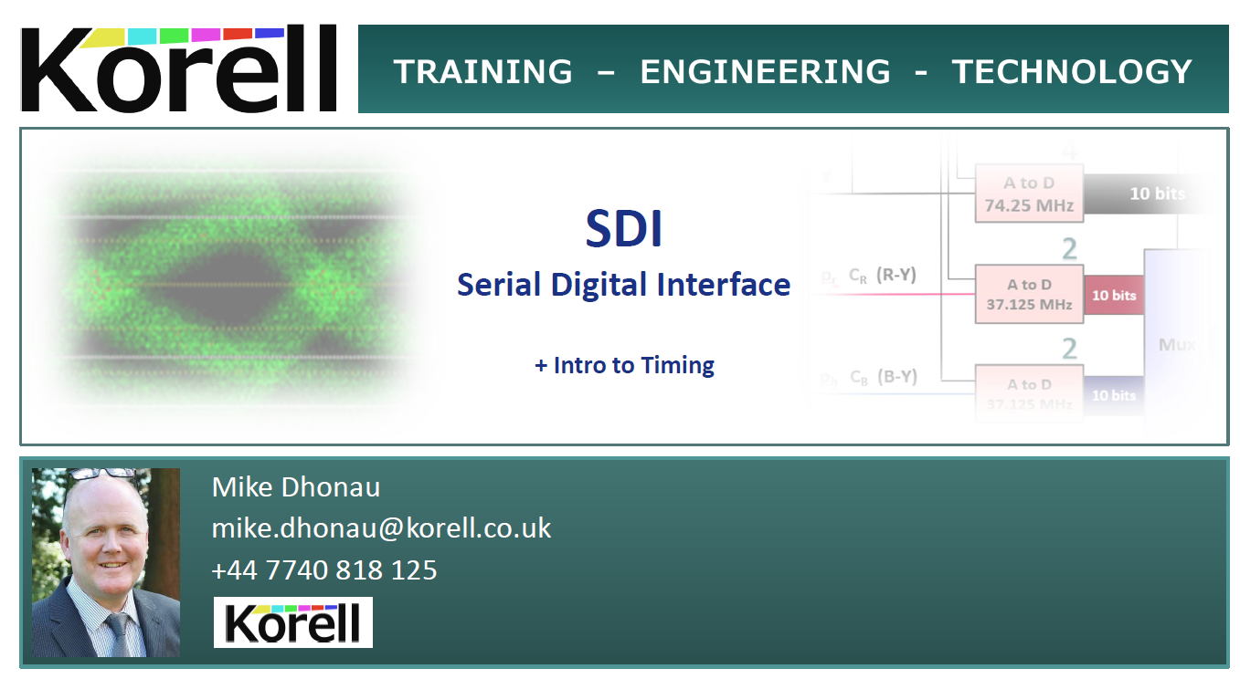

Slide 5
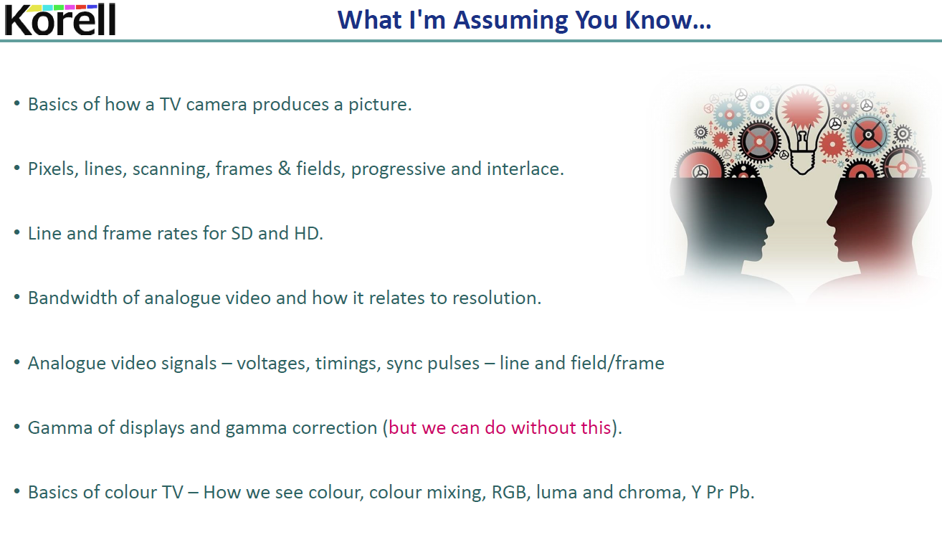

Slide 6
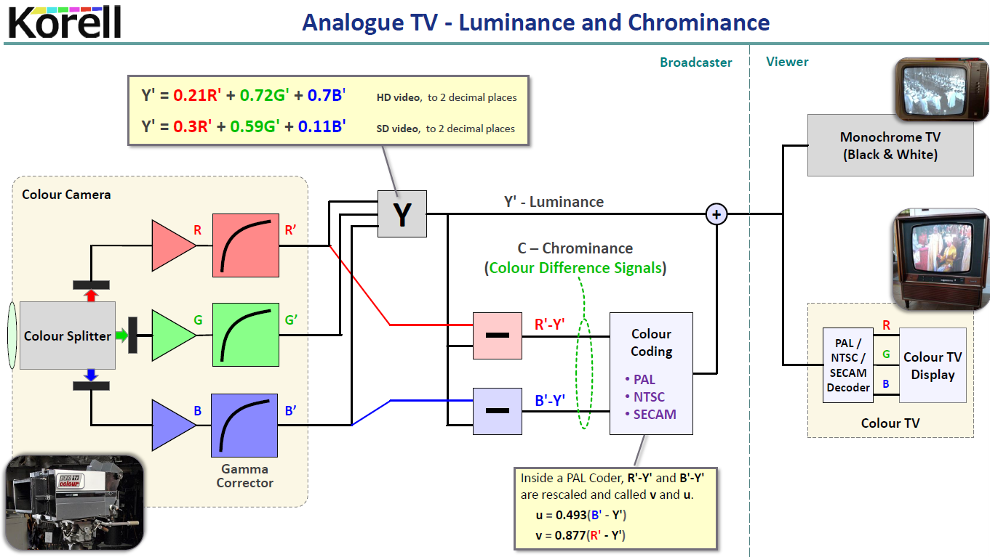
Luma encoding formula:
0.07B’
BT.709 standard
BT.601 standard

Slide 7
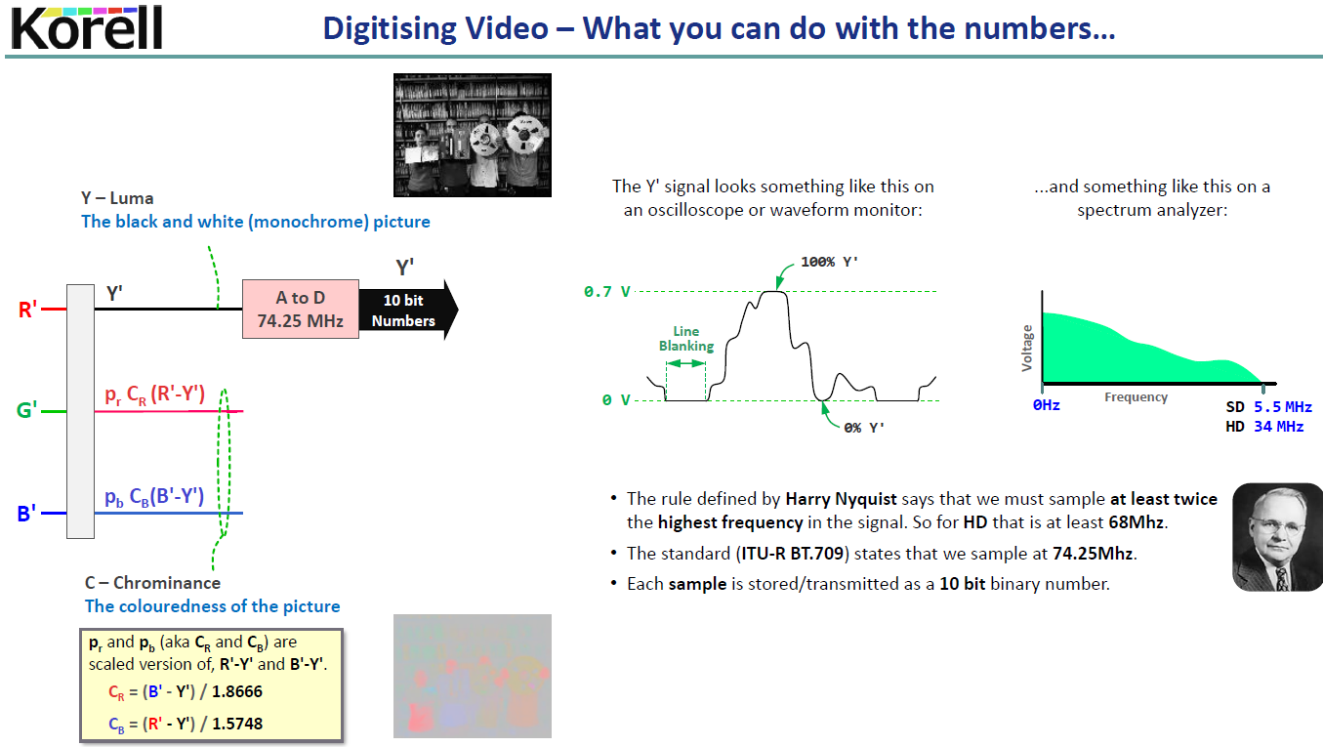
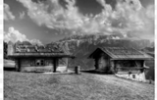



The Luma signal (Y’)

Slide 8
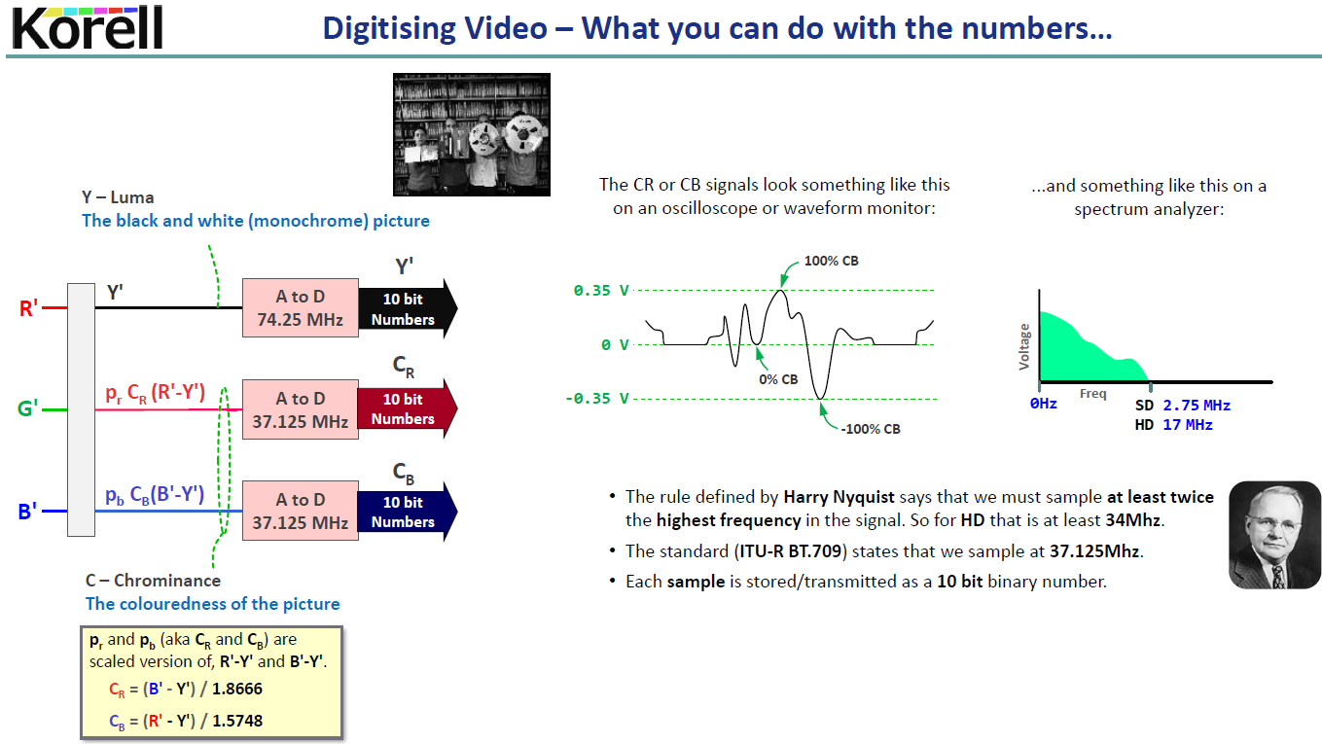
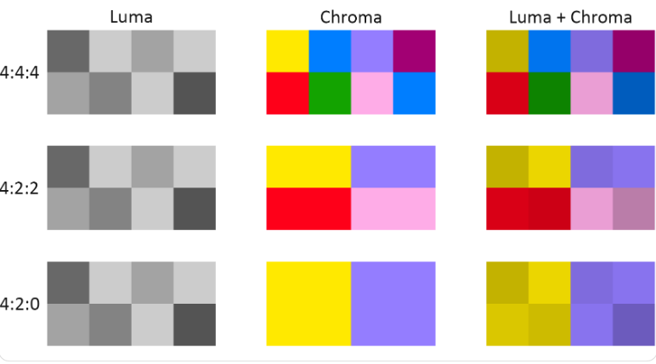
The Chroma signals (C_{R}, C_{B})
Chroma sub-sampled bandwidths
Chroma sub-sampling - Revision

Slide 9
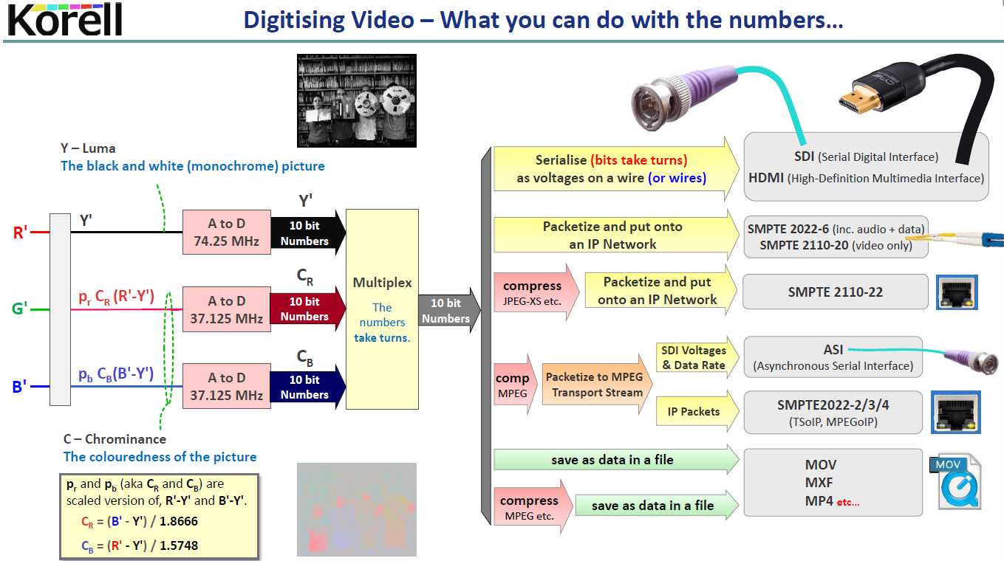

Slide 10
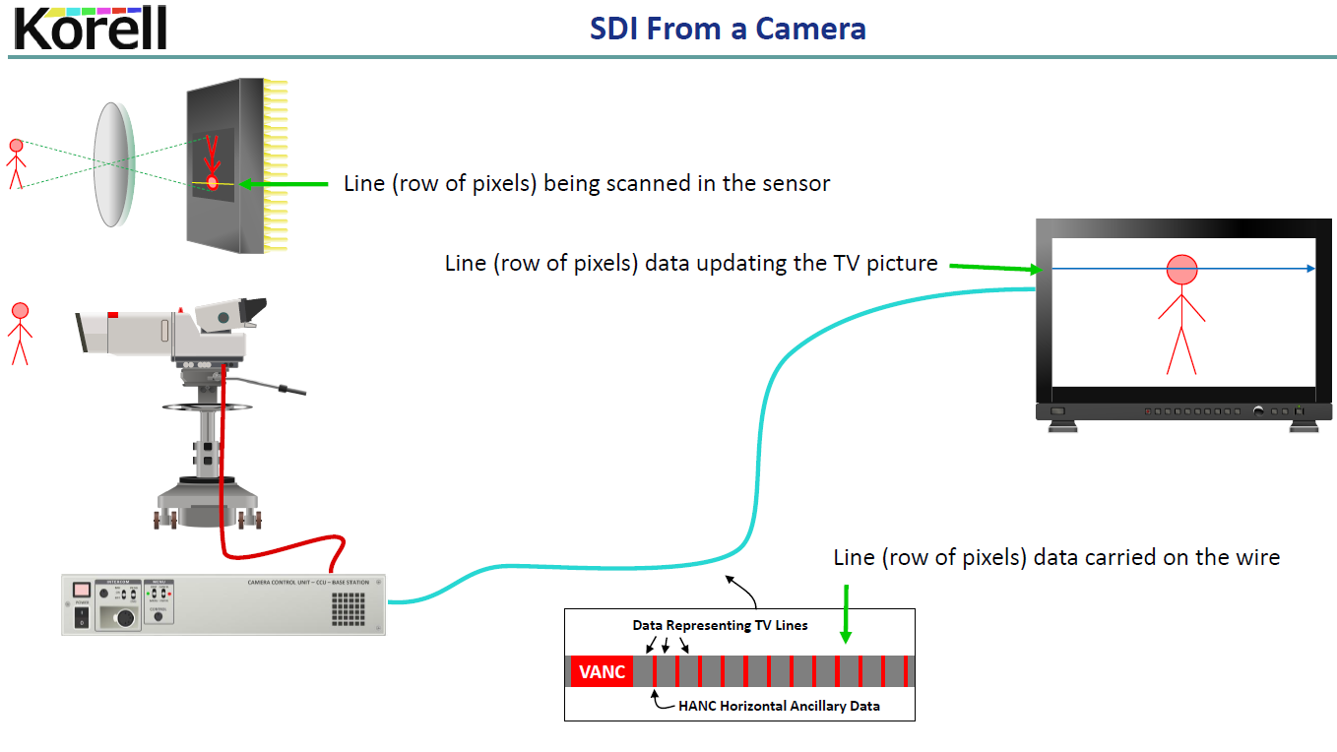
Encoding additional data in the signal
Vertical sync and VANC data
Line 1
Line blanking, sync and HANC data
Line 2
Line blanking, sync and HANC data
Line 3
etc …

Slide 11
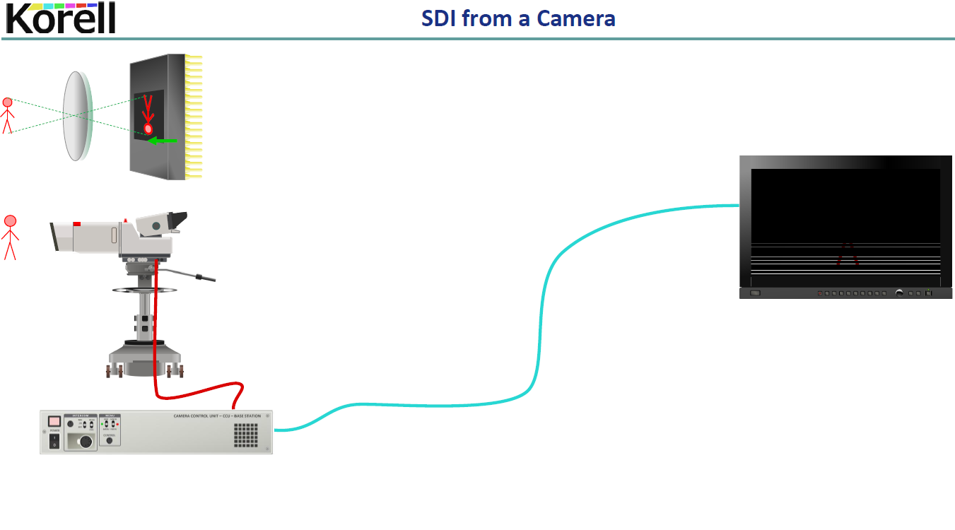
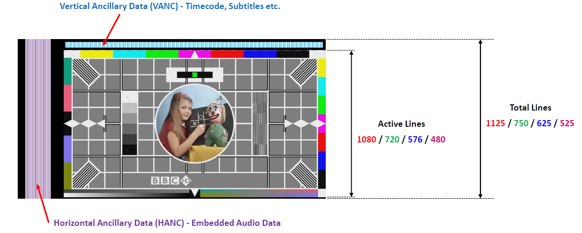
Encoding additional data in the signal – HANC and VANC

Slide 12
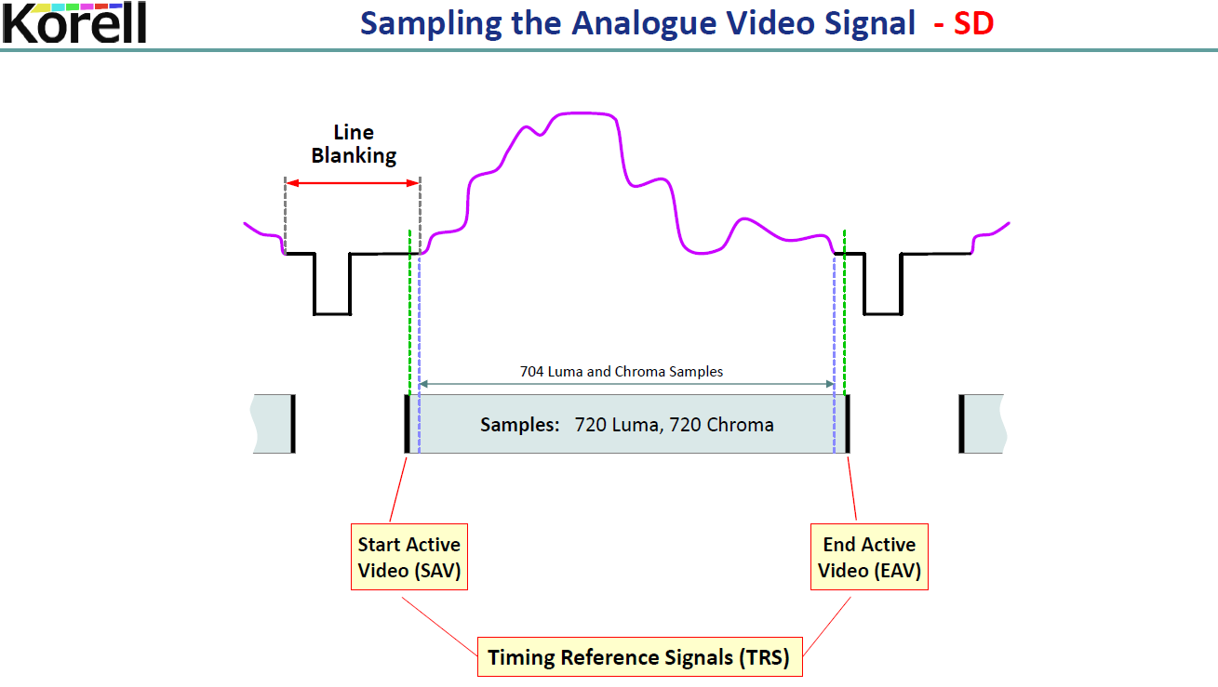
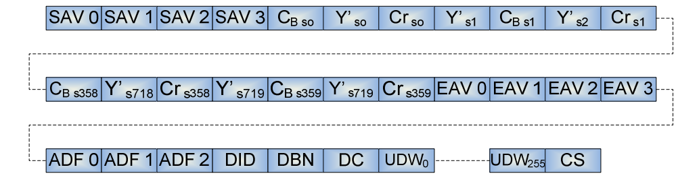
ITU-R BT.601 sampling rates at 13.5 MHz for 4:3 video gives 704 active pixels per line.
i.e. a raw capture at 720 samples / line cropped to 704 samples to fit the 4:3 aspect ratio
Video Line (10b words)
4 word SAV
SDI SMPTE Primer
ADF = Ancilliary Data Flag

Slide 13
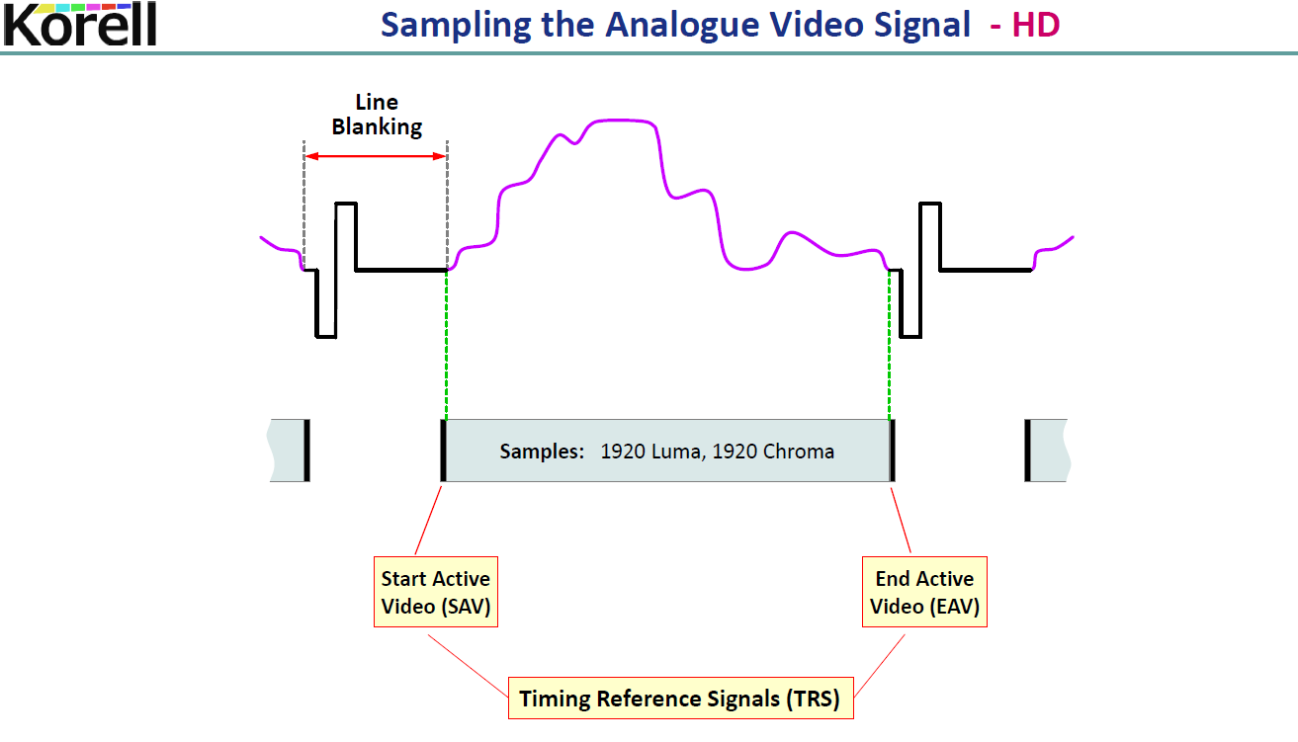

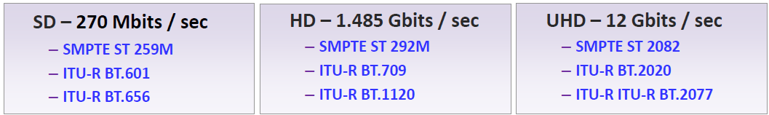
tri-level sync

Slide 14
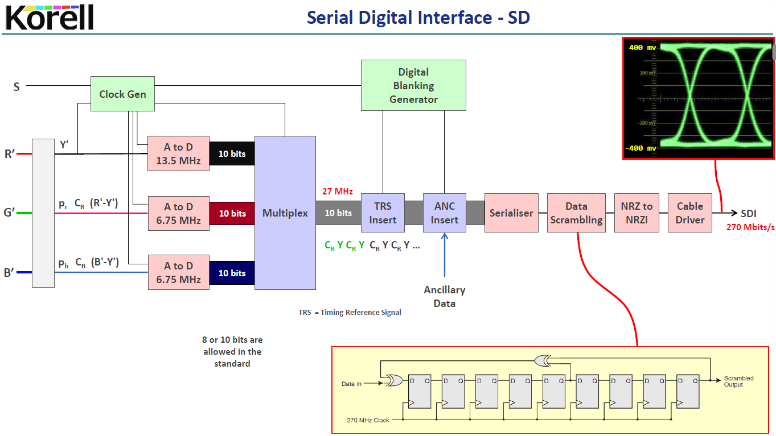
see next slide
to reduce long strings of 1’s or 0’s

Slide 15
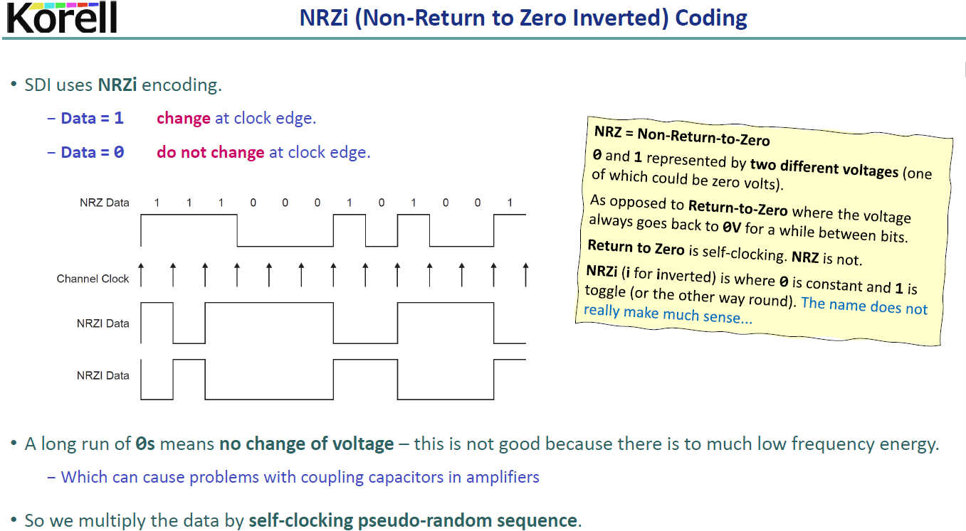
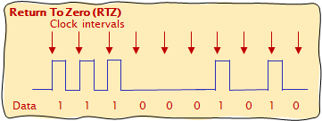
compare to RTZ

Slide 16
IP Workflows
Why IP is replacing SDI*
for example …
Universal connectivity (broadcast and other industries)
Lower budgets, higher quality requirements
Production companies scaling:
IP allows production personnel to remain in a central location
Receive feeds from remote locations
Democratise the industry
single producer can have many camera inputs from anywhere in the world
* although SDI is still in development

Slide 17
The Move to IP: SMPTE 2022, 2110
SMPTE ST 2022-6 - IP Packetisation of SDI Raster
mapping SDI onto IP
i.e. the early stages of the shift from SDI
ST 2110 – Essence-Based Approach
Designed from the ground up - separates video, audio and ancillary data
Flexibility: route and process streams independently
allows SDI ⇨SMPTE 2022-6 when necessary

Slide 18
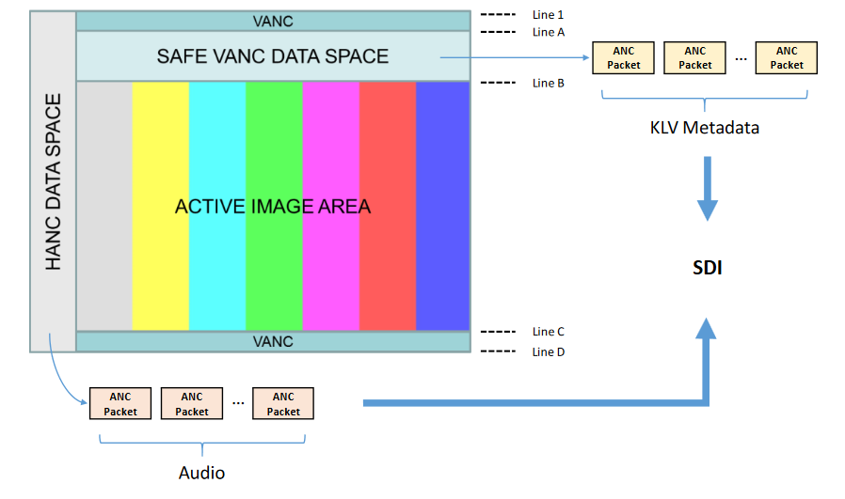
SMPTE ST 2022-6
- IP Packetisation of SDI Raster
Bundled (Audio, Video, Metadata together)
Audio/Video/Metadata/Sync travel coherently
Requires extra work to “unpack” separate essences
One IP Address
Video
+ Audio
+ ANC Metadata

Slide 19



ST 2110
– Essence-Based Approach
Essence Based (Audio, Video, Metadata separate)
Suited for Studio/Production workflows
Individual essence kept in sync using PTP timing
No blanking!
IP Packetisation of Active Video
IP Address #1
Video
IETF RFC 4175
IP Packetisation of Audio Channels
AES-67
IP Address #2
Audio
IP Packetisation of ANC Data
IETF ANC291
IP Address #3
Metadata

Slide 20
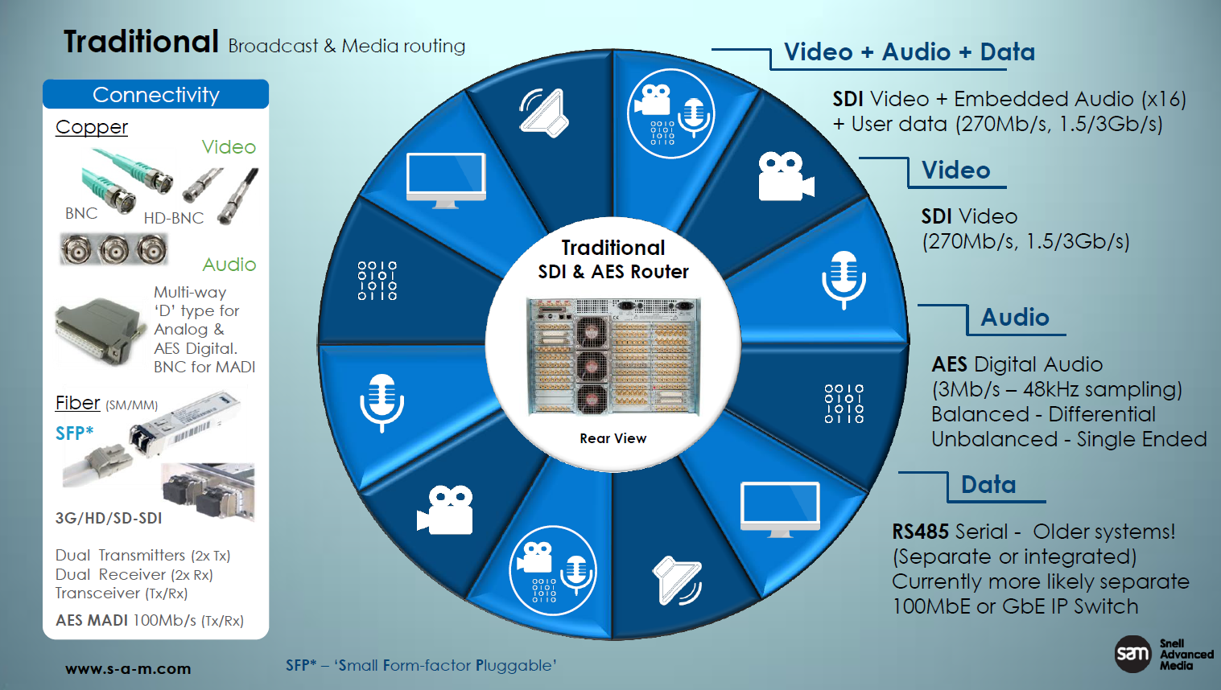

Traditional Broadcast and Media Routing
Slide from Phil Myers, Snell Advanced Media, SMPTE presentation, BCU. 2017

Slide 21
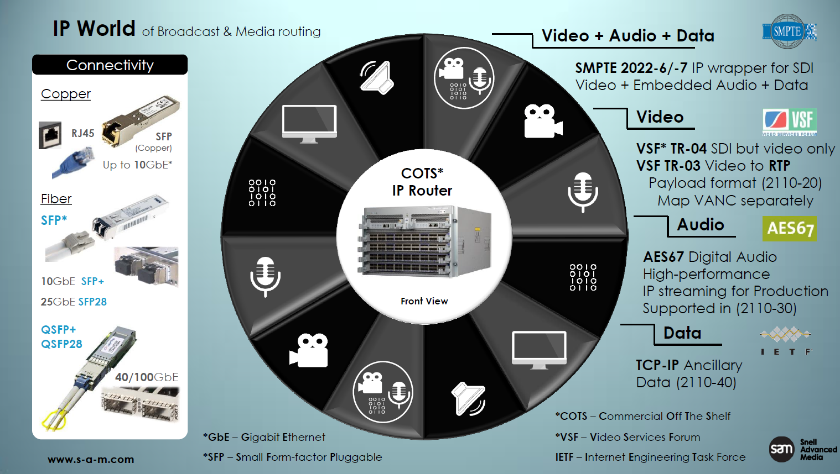
IP World of Broadcast and Media Routing
Note – SDI and IP in path from 2022 - 2110
Slide from Phil Myers, Snell Advanced Media, SMPTE presentation, BCU. 2017

Slide 22

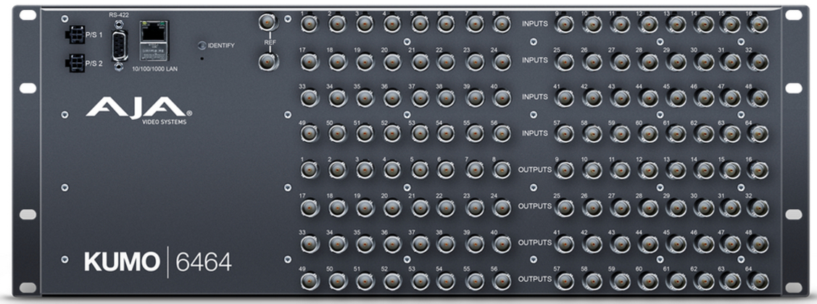
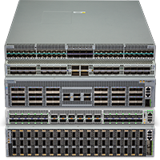
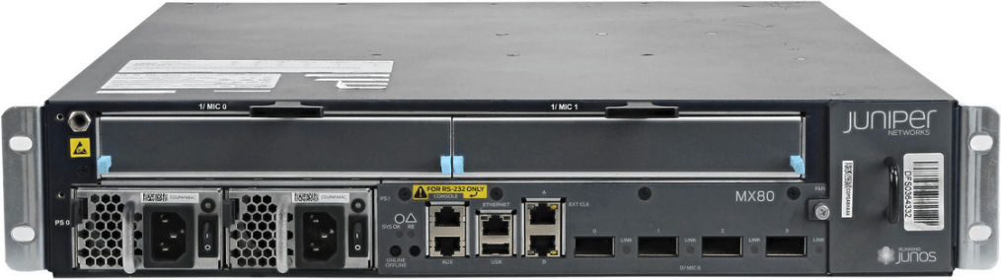
SDI vs IP Video Routing
SDI
All routing via SDI crosspoint frame
what to switch where
switches everything internally
receivers receive all data sent to them
IP
Receiver requests multicast
Control System tells Receiver:
Multicast Group & Port#
Technical Metadata of the new stream
Receiver is responsible for how it switches/transitions to it
Receiver asks the network for the new signal
Network sends data via packet forwarding logic
Multicast source
Receiver host

Slide 23
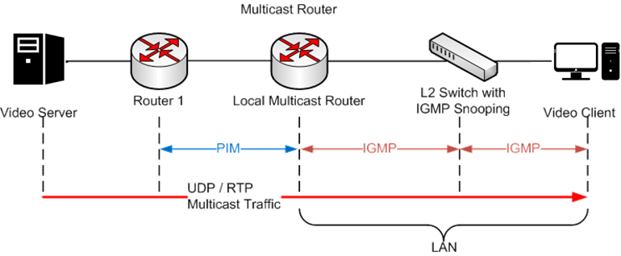
COTS and IP Video Routers
IP Video Routers
High bandwidth - > 130Tb/s, > 60B packets/s
Non Blocking – router internal bandwidth can handle all port traffic simultaneously at full capacity
IGMP to establish multicast groups
PIM-SSM (Protocol Independent Multicast, Source Specific Multicast) – allows a client receive multicast traffic direct from source

Slide 24
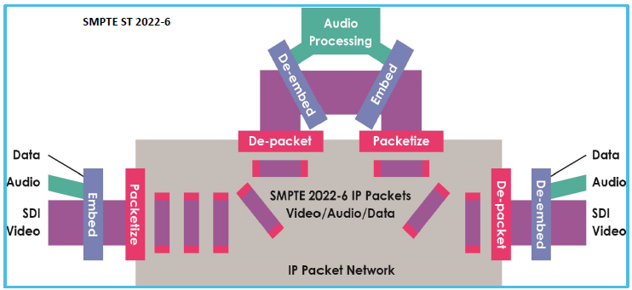
SMPTE ST 2022-6 (Multiplexed Streams)
Slide from Phil Myers, Snell Advanced Media, SMPTE presentation, BCU. 2017

Slide 25
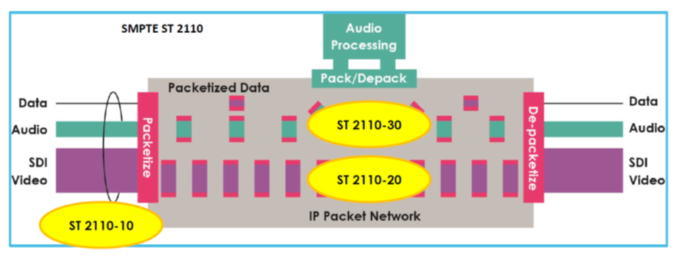
SMPTE ST 2110 – Essence Streams
Slide from Phil Myers, Snell Advanced Media, SMPTE presentation, BCU. 2017

Slide 26
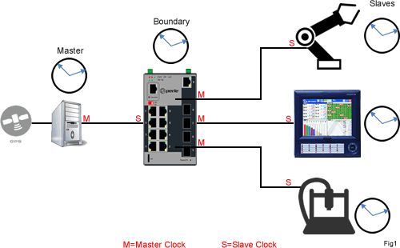
Precision Time Protocol (PTP)
https://www.tvtechnology.com/opinions/new-standard-for-studio-video-over-ip-approved
SMPTE ST 2022-6 and TR-03 / ST 2110
Issue -
propagation delays in the Ethernet
processor queuing, IP message creation and latency
PTP
protocol messages sent between PTP nodes
clock offsets; delays in the network
Proven technology across multiple industries (IEEE 1588)
common clock distributed to every node on the network
Can replace Black Burst, or work alongside it
Enables time alignment of separately transported essences

Slide 27
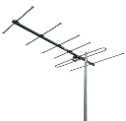
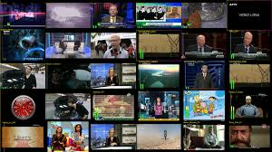
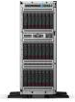

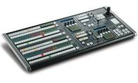

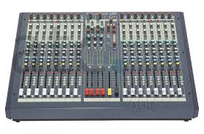
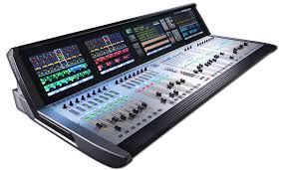
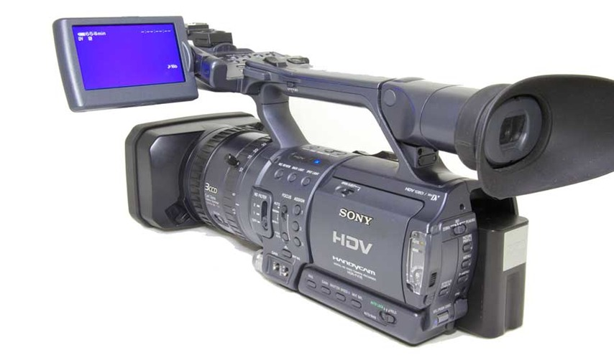
Example IP Media Facility
Off Air Rx
Timing Reference
Multiviewer Monitoring
2022-2
PTP
Rx Decoder
Decoder
Telco
IEEE 1588
2022-2
2022-6
2022-6
Tx Encoder
VSF TR-01
WAN Codec
2022-6
2022-6
Publish/Playout
Master Control
2110-40
Internet
Ancillary Data
Record replay
2110
MPEG DASH
2110-20
2110-30
(AES 67)
2110-20
Vision Mixer
2110-30
(AES 67)
Graphics System
OTT Coder
2110-20
OTT Coder
OTT Coder
Sound Mixer

Slide 28

Digital TV Distribution …
DVB

Slide 29
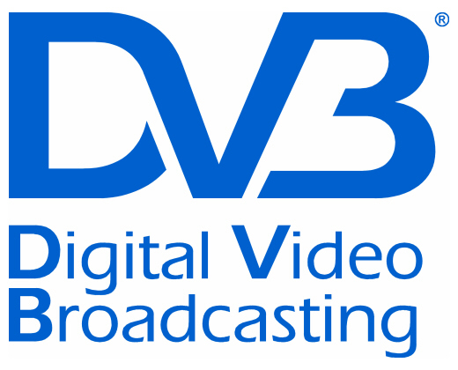
DVB - Digital Video Broadcasting
Standards
Satellite DVB-S, DVB-S2, SH
Cable DVB-C, DVB-C2
DTT DVB-T, DVB-T2
DTT for handhelds DVB-H, DVB-H2
IPTV DVB-IPTV
DASH DVB-DASH
DVB-3DTV - Frame Compatible Plano-Stereoscopic 3DTV
DVB-C2 - 2nd Generation Cable Transmission
DVB-CID - Carrier Identification for Satellite Transmission
DVB-CPCM - Content Protection and Copy Management
DVB-FF - DVB File Format
DVB-GEM - Globally Executable MHP
DVB-GSE - Generic Stream Encapsulation
DVB-H - Broadcasting to Handheld Devices
DVB-IPDC - Internet Protocol Datacasting
DVB-IPTV - Internet Protocol Television
DVB-MHP - Open Middleware for Interactive TV
DVB-PCF - Portable Content Format
DVB-RCS2 - Return Channel Satellite
DVB-RCT - Return Channel Terrestrial (03/2001)
DVB-S2 - 2nd Generation Satellite Broadcasting
DVB-SH - Satellite Services to Handheld Devices
DVB-T - Digital Terrestrial Television
DVB-T2 - 2nd Generation Terrestrial Broadcasting
DVB - Emergency Warning System
DVB Project - An Introduction
Hierarchical Modulation in DVB-T (03/2000)
plus many others (inc addenda, etc) …
Industry Organisation
Standardisation Process –
Joint Technical Committee (JTC) of:
ETSI - European Telecommunications Standards Institute
CENELEC - European Committee for Electrotechnical Standardization CENELEC
EBU - European Broadcasting Union
Note standards refer to other standards and patents, e.g. MPEG
http://www.dvb.org/standards/factsheets

Slide 30
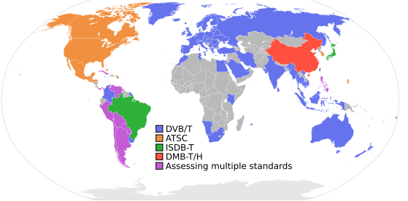
Digital Terrestrial TV (DTT)
Digital Video Broadcast, Terrestrial Television - DVB-T
Europe; also DVB-S for Satellite, DVB-C for Cable; DVB-H for handhelds
MPEG2 format; also
Integrated Services Digital Broadcasting, Television - ISDB-T
Japan; also ISDB-S for Satellite, ISDB-C for CableTV
MPEG2 format
Modulation: PSK, COFDM/PSK/QAM
Advanced Television Systems Committee - ATSC-8VSB
Modulation: 8VSB: 8-level Vestigial Sideband
American Continent
MPEG2-TS

Slide 31
DVB Specifies …
Specifies - essentially a layer one protocol for transport with Data Link (Transport Streams, GSE, etc)
Including -
Input Interface
usually Transport Streams - i.e. TV
Generic Stream Encapsulation – e.g. IP
Modes
Variable Coding and Modulation
Adaptive Coding and Modulation
FEC
e.g. DVB-T2: LDCP, BCH ½. 3/5. 2/3. ¾. 4/5. 5/6
Modulation
e.g. DVB-T2: OFDM
Modulation Schemes
Q/8/16/32PSK, QAM
e.g. DVB-C2: 16-4096QAM
Guard Interval
e.g. DVB-T2: 1/4, 19/256, 1/8, 19/128, 1/16, 1/32, 1/128 (fractions of a symbol)
Interleaving
Bit- Time- and Frequency-Interleaving

Slide 32
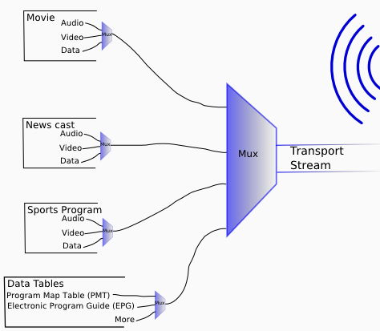
Transport Stream Multiplex
Transmission:
Terrestrial
Cable
Satellite
Broadband
Program Streams

Slide 33

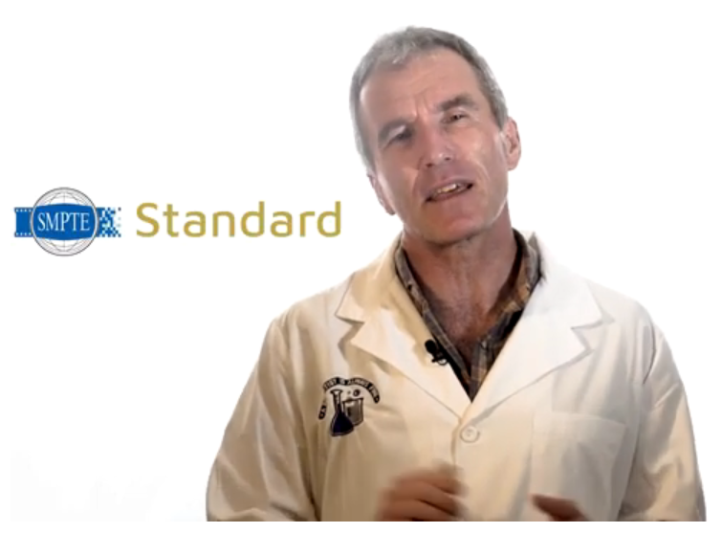
Distribution Network Architectures
These are the SMPTE colour bars, used for monitor calibration
See this from Bruce Devlin about SMPTE standards
https://www.smpte.org/top-standards
… there are many standards bodies involved in the media industry …
MPEG, DVB, DTG, ITU, AMWA, DPP, ETSI …
… and many others

Slide 34
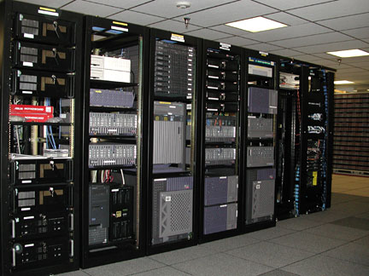
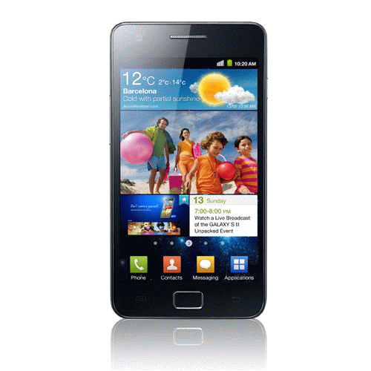
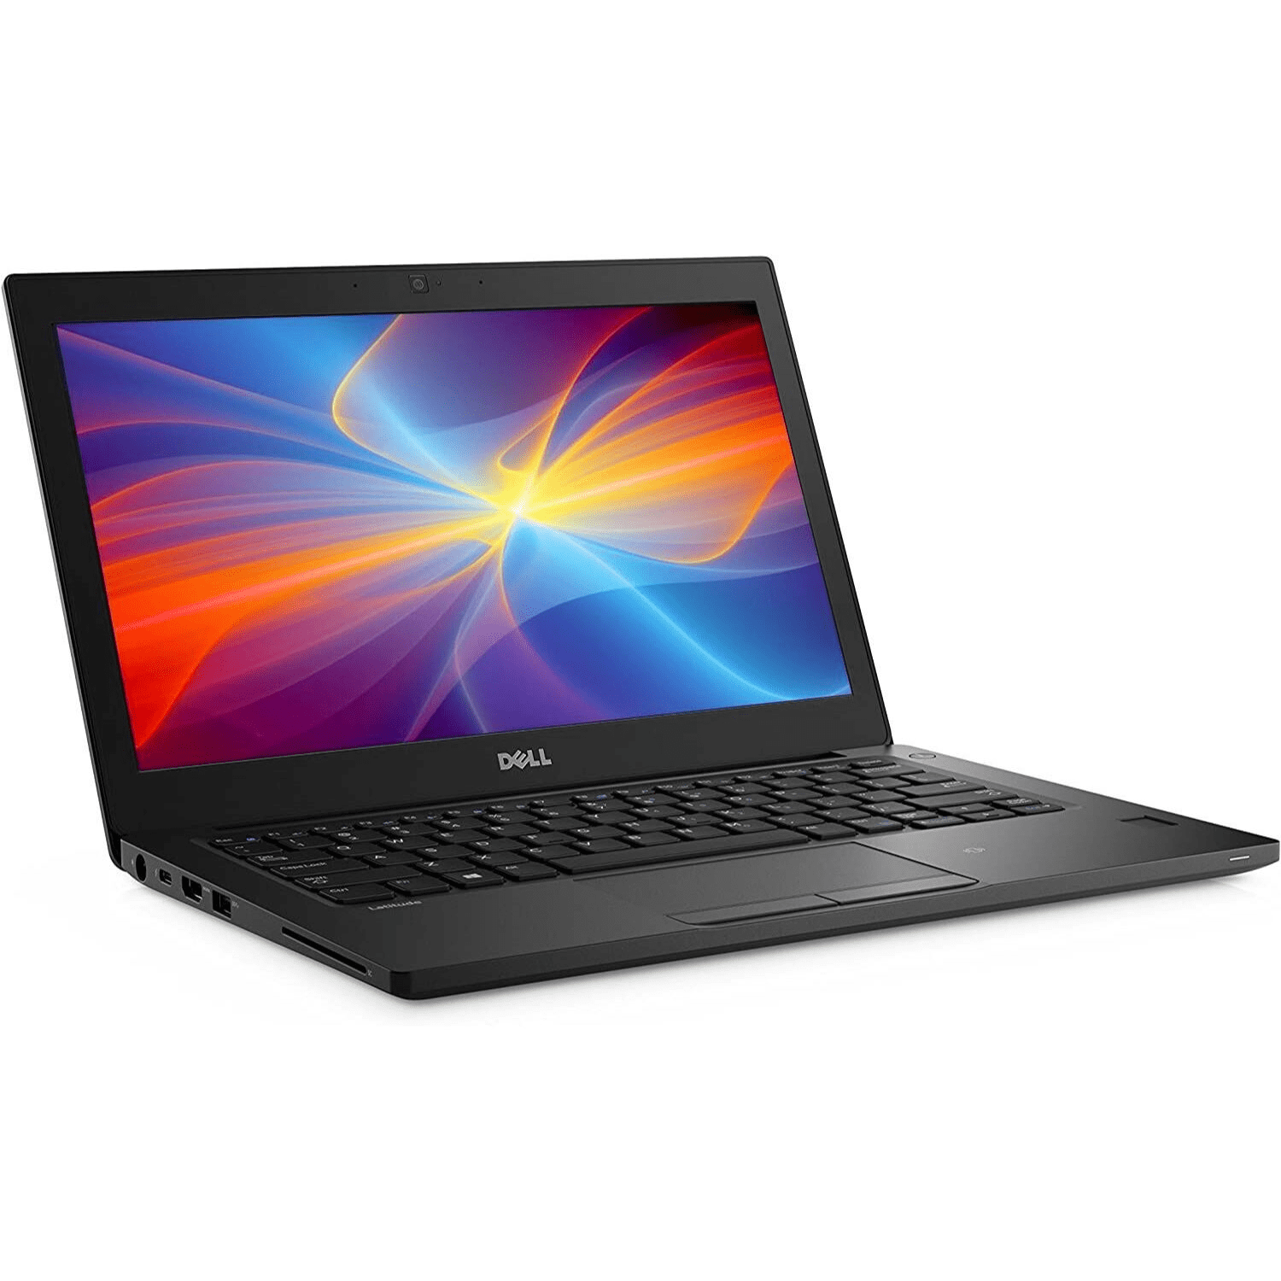
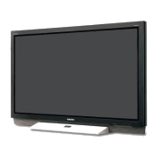
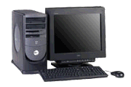
Distribution Network Architectures
e.g. -
Terrestrial
Cable
Satellite
IPTV
headend
distribution network
ingest or other content acquisition
edge network
WWW
modem/router
End user premises

Slide 35
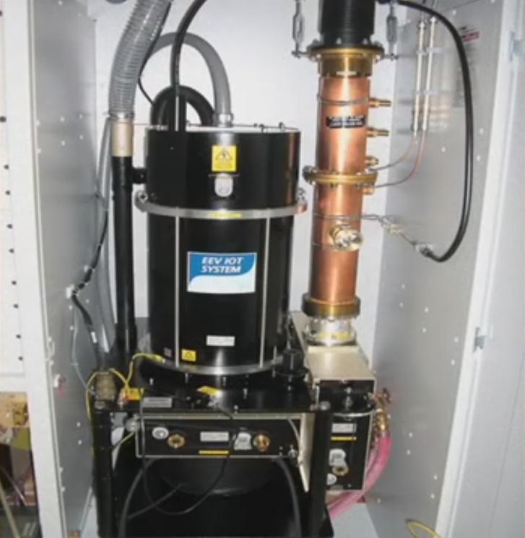
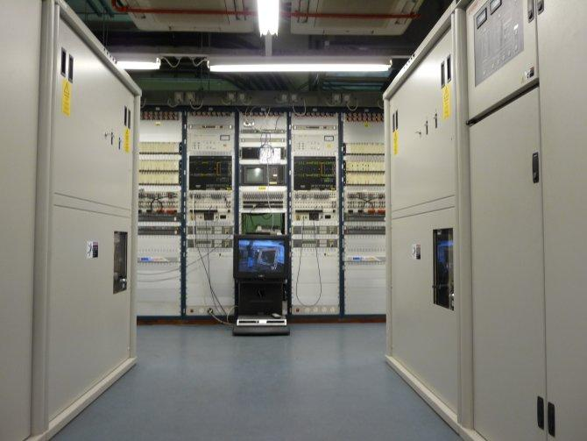
Digital Terrestrial
TV
(DTTV,
e.g.
Freeview)

Slide 36
Digital Terrestrial TV (DTTV, e.g. Freeview)
7Mhz Channel
contains a number of DVB-T TV channels
Ch21
48 channels
Ch68
475MHz
850MHz
UHF Band IV, V

Slide 37
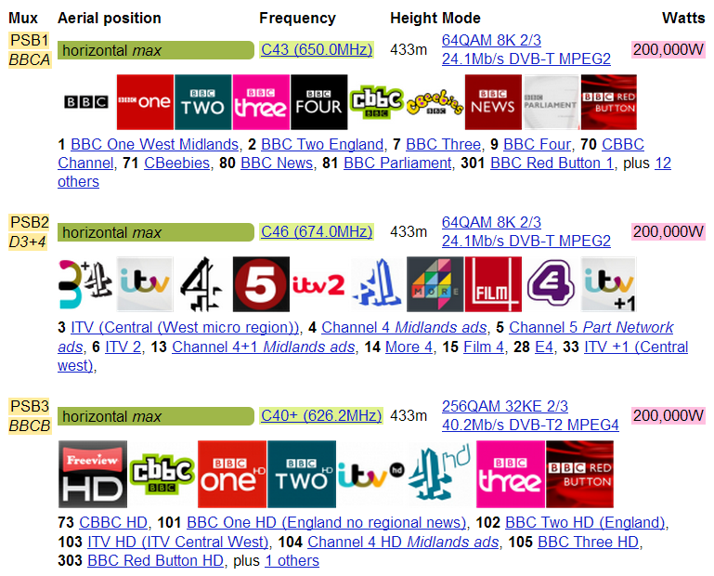
Freeview – Sutton Coldfield Transmissions (9 Multiplexes altogether)

Slide 38
Digital Terrestrial TV (DTTV, e.g. Freeview)
7Mhz Channel
contains a number of DVB-T TV channels
– a transport stream modulated on many carriers
Ch21
48 channels
Ch68
475MHz
850MHz
UHF Band IV, V

Slide 39
Multiplexing the Channels
V
Ch1
V
Ch3
V
Ch4
A
Ch1
V
Ch3
D
Ch2
SI
Ch1
V
Ch1
V
Ch4
Total data to be transmitted
00100010010101011110010010001001010101110010011001010100010100000.........
Data is modulated on to each of several carriers
freq
Each of these is one carrier with data modulated on to it in Quadrature Amplitude Modulation
(QAM – a mix of amplitude and phase modulation)
All these carriers are separate signals

Slide 40
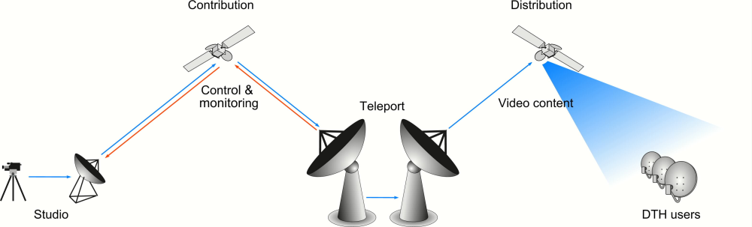
Satellite Distribution
Video Headend
image from
http://upload.wikimedia.org/wikipedia/en/8/80/Sat_contribution_fig.jpg

Slide 41
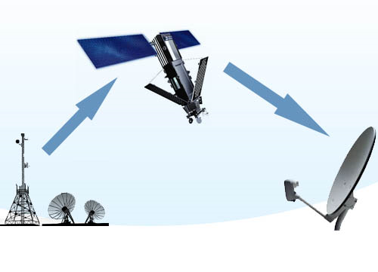
Satellite TV
DBS - Direct Broadcast Satellite; Broadcasting Satellite Service
One-way broadcast
From a communications satellite to an end user
Uplink: large dish 9-12m dia
Receiver - Small round or oval dish antenna < 20" diameter.
Compressed digital signal in the K_{u} band
(11-15GHz)
Reception affected by
rain
solar activity
http://www.supersatelliteselection.com/how-satellite-tv-works.html

Slide 42
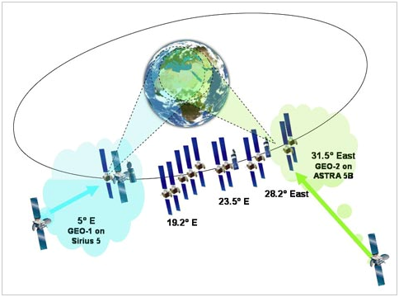

Geostationary Orbit
36,000 km
= 22,250 miles
Some satellite data …
SES Astra satellites located at 28.2° east (Astra 2A/2B/2C/2D)
Eutelsat's Eurobird 1 satellite at 28.5°E
appears as a fixed position to an earth-based observer
revolves around the earth at a constant speed once per day over the equator
ground based antennae - no need for expensive tracking equipment
receiver dish parameters

Slide 43


Satellite Transponders
Each Transponder is a separate transceiver or repeater
Each transmission channel is a multiplex of several digital TV channels
(note – bigger transmission channels than DTT
∴ many more TV channels in each multiplex)
24 x 36MHz transmission channels in 11GHz band
24 x 36MHz channels in 6GHz band
http://www.dream.com.ph/howdreamworks/hwd_schematic.asp

Slide 44


LNB - Low Noise Block
Signal is polarised in horizontal or vertical plane
LNB: waveguide with H / V detector
Superheterodyne principle next slide …
Receives wide band of relatively high frequencies ...
Amplify and convert them to much lower frequency - intermediate frequency, IF
IF: 900 – 2100 MHz)
Lower frequencies - much less attenuation in cables on user end
Easier and cheaper circuit design for lower frequencies
Feeder Horn
LNB Unit

Slide 45


Cable TV

Slide 46




Cable TV
HFC network - hybrid fibre-coax network
Combine both optical-fibre and coaxial cable lines.
Optical fibre
- from the cable head-end to neighbourhoods of 500 to 2,000 subscribers.
Hybrid networks:
fibre's reliability and bandwidth benefits
lower cost than a pure fibre network
utilising existing copper plant
TAP
Fibre Trunk
Coax Trunk
Headend
Router
TAP
Branch
Drop
TAP
Coaxial cable
- from the optical-fibre feeders to each subscriber's home.
Network Economics!!
Where to install fibre or coax?
When to replace coax with fibre?
Cost of build (equpt and labour) ?
What additional services/revenues ?
Notes:
-----------------------------------------
>> CMTS

Slide 47

Cable TV – Data and TV to the user
Interface
DOCSIS
Data
DOCSIS - Data Over Cable Service Interface Specification
The Standard for the interface between the CMTS and the Cable Modem
Developed and licensed by CableLabs
Specifies modulation schemes and protocol
for exchanging signals over cable
to carry MPEG and IP

Slide 48
Telecomms Service Providers (Telco)
Broadband Access

Slide 49
Telco Broadband Access
Initially - ADSL, XDSL via twisted pair cable
Telephony
UPSTREAM
DOWNSTREAM
signal
freq
sub-channels
… but (increasingly) Ethernet over fibre

Slide 50







Telco Broadband (IPTV)
VOD Server
Middleware
Broadcast
Video Head-End
FTTC
IP Router
DSLAM
Digital Subscriber’s Line Access Module
Router (+WiFi)
WWW
Network
Customer Premises
PSTN
Public Service Telephone Network
Notes:
IP services
>>>> - SSw
>>>> - www
>>>> - Walled Garden
>>>> - video headend
>>>> Network
- (MSAN)
IP Router
- ASX4000, BXR 48000
>>>> B-RAS
migrate to edge - to MSAN
[more later]
---------------------
Second Mile - Ethernet

Slide 51

Mobile N/W
VOD Server
Middleware
Broadcast
Video Head-End
Ethernet
Fibre
FTTH
FTTP
IP Router
Street
Cabinet
DSLAM
Router (+WiFi)
Walled Garden
bRAS
WWW
Network
Customer Premises
PSTN access

Slide 52
Streaming
HTTP, HLS
MPEG-DASH
RTP/RTSP

Slide 53
HTTP Streaming
Early days of HTTP media distribution
Limited bandwidth available
“Download and play”
no lookahead seeking or random access
Multiple viewers – server bandwidth issues
HTTP overtaken by RTP/RTSP systems for large IPTV deployments
Real Time Protocol
using Real Time Streaming Protocol requests
this needs a fairly well engineered architecture including firewalls which pass RTP traffic
HTTP more recently back in favour
uses generic HTTP servers (often based on Apache or Windows Server)

Slide 54
Streaming Media Protocols – HTTP addresses RTMP Issues
RTMP/RTSP/HTTP for distribution to viewers - state of the market
little impetus for RTMP/RTSP sites to change –still widely used
widely used in IP production workflows
But … for distribution to end users - overwhelming view – HTTP
(in fact most video content is delivered via plain old HTTP progressive download)

Slide 55
How can we use HTTP for streaming? … Adaptive Bit Rate (ABR)
HTTP server/client – stateless
HTTP-ABR streaming: retrieves consecutive short chunks on as-needed basis
little waste (the video is delivered as it is watched)
server efficiently serves more streams
Random seeking
(viewer selects – player retrieves the appropriate chunks)
firewall friendly
can utilise HTTP caching mechanisms
less expensive to implement (no streaming server required)
scale more cheaply and effectively to serve available users

Slide 56
HTTP Streaming – now Adaptive bit-rate (ABR)
Client
Server
Segment timing:
10 seconds = reasonable balance for most broadcast content
Shorter segments
= more frequent refreshes of the index file
.. unnecessary network overhead for the client
Longer segments
= latency and initial startup time
Media Formats
e.g. video: H.264/5
audio: .aac / Opus, etc
video + audio file segments unwrapped
… but certain applications –
can be wrapped in MPEG-TS (DVB)
index file
http GET
Audio segment
http GET
Video segment
etc

Slide 57

HTTP Live Streaming - HLS (DASH is similar)
Apple (part of QuickTime and iOS)
HLS current version is 7.0

Slide 58

MPEG-DASH
Dynamic Adaptive Streaming over HTTP
Background
HTTP streaming is OK - provided that the increased latency is acceptable
Benefits:
Firewall and NAT traversal
(c.f. services based on RTP/UDP)
Widely deployed network caches (CDNs)
Deployment of CDN caches can be kept simple
Complexity (adaptation) moved to client
Servers are agnostic to delivered content
network resources / configuration may vary over time
http://www.streamingmedia.com/Articles/ReadArticle.aspx?ArticleID=79041

Slide 59

MPEG-DASH
Streaming content
from HTTP server
to a DASH client
content stored on HTTP server; delivered using HTTP
Content exists on the server in two parts:
Media Presentation Description (MPD)
content presentation types
various alternatives
URL addresses, etc
Media Segments
contain the content bitstreams
chunks, single or multiple files

Slide 60

MPEG-DASH
DASH client obtains the MPD …
Media
Presentation
Description
… an XML document
The MPD:
delivered using HTTP or other transport
describes media data available at the servers
allows clients to select the data
defines segments available
can either be
initialization segments - initialization data for decoding
the actual media segments
Uses ISO base Media File Format (ISOBMFF - general structure for time-based media
however, segments based on other formats can be specified

Slide 61
MPEG-DASH
DASH client learns about -
program timing
media-content availability
media types
Resolutions
minimum and maximum bandwidths
the existence of various encoded alternatives of multimedia components
accessibility features and required digital rights management (DRM)
media-component locations on the network
other content characteristics
Then DASH client selects the appropriate encoded
… starts streaming content using HTTP GET requests to fetch segments

Slide 62
MPEG-DASH
Media transfer continues:
Buffering to allow for network throughput variations
Client continues fetching subsequent segments
monitors network bandwidth fluctuations
adapts to available bandwidth by fetching segments of appropriate bitrate to maintain an adequate buffer
MPEG-DASH specification only defines
MPD
segment formats
Outside of MPEG-DASH’s scope:
how MPD is delivered
media-encoding formats containing the segments
client behaviour for fetching, adaptation heuristics, and playing content

Slide 63


On-Demand Vs Live Streaming
result of n/w jitter
Live media needs live compression stage
(already compressed)
On-demand streaming (stored video)
Live streaming

Slide 64
Media Containers
Container Format - a meta file format specification
how different multimedia data elements (streams) and metadata coexist in files
A container format provides the following:
Stream Encapsulation
One or more media streams can exist in one single file.
Timing/Synchronization
The container adds data on how the different streams in the file can be used together. E.g. The correct timestamps for synchronizing lip-movement in a video stream with speech found in the audio stream.
Seeking
The container provides information to which point in time a movie can be jumped to. E.g. The viewer wants to watch only a part of a whole movie.
Metadata
There are many flavours of metadata. It is possible to add them to a movie using a container format. E.g. the language of an audio stream.
(also subtitles considered as metadata)
https://bitmovin.com/container-formats-fun-1/

Slide 65
Common Media Application Format - CMAF
(See previous notes on HTTP Live Streaming …)
A Transport Stream (TS) is ill-suited to segmented media delivery and switching
HLS uses TS
DASH - allows TS but mostly ISO Base Media File Format (ISOBMFF)
First – some background on container formats ⇨⇨⇨
https://agama.tv/what-is-cmaf-and-why-does-it-matter/

Slide 66
Media Containers
Container Format - a meta file format specification
how different multimedia data elements (streams) and metadata coexist in files
A container format provides the following:
Stream Encapsulation
One or more media streams can exist in one single file.
Timing/Synchronization
The container adds data on how the different streams in the file can be used together.
E.g. timestamps for synchronization
Seeking
The container provides information to a specific point in a video
Metadata
There are many flavours of metadata. It is possible to add them to a movie using a container format.
E.g. the language of an audio stream.
subtitles also considered as metadata
… now back to CMAF ⇨⇨⇨
https://bitmovin.com/container-formats-fun-1/

Slide 67
Common Media Application Format - CMAF
2016: MPEG cross industry proposal:
“Common Media Format for Segmented Media”
⇒ Media Application Format (MAF)
MAF - “selecting tested and verified tools from MPEG standards
... appropriate selection for the envisioned application.
based on ISO Base Media File Format (ISOBMFF) + other MPEG standards
Became Common Media Application Format
CMAF - MPEG-A Part 19 or ISO/IEC 23000-19
CMAF Aim:
To allow a single media encoding format to be used
across many applications and devices

Slide 68
Common Media Application Format - CMAF
CMAF defines
encoding
storage
identification
subtitles/captions
packaging of segmented media objects
for delivery and decoding on end user devices in adaptive multimedia presentations
segment format based on ISOBMFF
not the manifest
c.f. MPEG-DASH Interoperability Guidelines mainly aligned with Apple aim to support fragmented MP4 (fMP4)
Ultimate aim: a single segment format for OTT - Currently the two formats are:
Transport Stream (TS)
ISOBMFF

Slide 69


DASH / CMAF
DASH Manifest vs CMAP media object model
MPD periods, contain multiple adaptation sets / representations
CMAF does not define a manifest
… but any manifest can be used to instantiate the CMAF media object model
Periods in DASH are presentations in CMAF
More information here

Slide 70
ISO BMFF – ISO Base Media File Format
ISO base media file format ISO/IEC 14496-12 – MPEG-4 Part 12
Defines time-based multimedia files
It is the basis for other media file formats, e.g. container formats MP4 and 3GP
a general structure for time-based video and audio files
flexible, extensible; facilitates interchange, management, editing and presentation of the media
Base components of ISOBMFF are boxes - also called atoms
boxes - classes and an object oriented approach
The base class:
Example FileTypeBox:
to identify the purpose and usage of an ISOBMFF file
often at the beginning of a file.
box can also have children and form a tree of boxes
e.g. MovieBox (moov) can have multiple TrackBoxes (trak)
track is a single media stream

Slide 71


Slide 72

Chroma Subsampling

Slide 73
RGB to Y,Cb,Cr
Y
During the encoding stage ...
Cb
RGB pixel format … … … is converted to … … … Y,Cb,Cr
where
Y = luminance (light intensity)
Cb, Cr = colour information
Cr
Weighted RGB converted to Y Cb, Cr
0.2989*R + 0.5870*G + 0.1140*B

Slide 74


RGB to Y,Cb,Cr – each pixel
Overall luminance
i.e. greyscale, monochrome
of this pixel
= Y, ... i.e. the luma
Weighted RGB luminance:
approx 29% Red + 59% Green + 11% Blue

Slide 75
RGB to Y,Cb,Cr – each pixel
Cb = B – Y
i.e. 8 bits of Cb (0-255)
value of Cb:
value of original Blue
minus
value of luma
= -
e.g.
= 210 - 90
1111000
11010010
similarly,
Cr = R – Y
= -
01011010
Overall luminance
i.e. greyscale, monochrome
of this pixel
= Y, ... i.e. the luma
Weighted RGB luminance:
approx 29% Red + 59% Green + 11% Blue

Slide 76
Y,Cb,Cr – for image of x x y pixels in “4:4:4”
y pixels
x pixels

Slide 77
Y,Cb,Cr – Chroma Sub-sampled to “4:1:1”
y pixels
Reason: To greatly reduce the amount of data
Rationale: The eye’s resolution of luminance is greater than for colour
x pixels

Slide 78

Y,Cb,Cr
Original image
YCbCr
Colour Space: Y = Luminence Information; Cr, Cb = Chrominance Information
Derived from RGB (gamma corrected)
Y is dominant information; RGB colour info derived from Y, Cr, Cb relationships
(simplified): Cb = B-Y ; Cr = R-Y
Y
Cb
Cr

Slide 79




RGB to Y,Cr,Cb
i.e. there are now three mappings of the original RGB image:
Y: Luminance intensity
Cb: Intensity of the values of
[B minus Y]
Cr: Intensity of the values of
[R minus Y]
Y
Y
Cb
Cb
Cr
Cr

Slide 80



Chroma Subsampling
Left – original RGB image:
12 x 8 pixels = 96 pixels
bits for each pixel = 8 red + 8 green + 8 blue
∴ 24b each pixel, total bits = 24 x 96 b
= 2304b (= 288 Bytes)
Bottom left, YCbCr, 4:4:4 : (is also 2304b)
Below, Chroma sub-sampled, 4:1:1:
Luma = 96 x 8 = 768
Chroma = 3 columns of Cr and Cb,
2 x 8b each C = 8 x 2 x 3 x 8 = 384 b
Total = 768+384 = 1152b (=144 B)
i.e. 50% saving

Slide 81

Reception / Decoding
encoding process
decoding process
Decoding, reverse process ...
from Chroma sub-sampled to full RGB
note – interpolating lost information
∴ detail is lost in the process
Perceptual (e.g. MPEG, etc ) encoding + decoding is also part of this process and loses a lot more detail
... more later in the module

Slide 82


Chroma Subsampling
Luma and chroma components
Weighted sum of gamma-corrected R'G'B‘ tristimulus components
instead of linear (tristimulus) RGB components
Luminance and colour detail are not completely independent of each another
"bleeding" of luminance and colour information between the luma and chroma components
i.e. because of the colour not represented in each pixel, and is interpolated for the final viewed image
greatest for highly-saturated colours
noticeable in between the magenta and green (when chroma subsampled)
without colour subsampling
with colour subsampling

Slide 83
Chroma Subsampling
commonly expressed as a three part ratio J:a:b (e.g. 4:2:2)
number of luminance and chrominance samples in a conceptual region
J pixels wide
2 pixels high
Parts
J = horizontal sampling reference (width of the conceptual region)
usually = 4
a = number of chrominance samples (Cr, Cb) in the first row of J pixels
b = number of changes of chrominance samples (Cr, Cb) between first and second row of J pixels
Alpha - horizontal factor (relative to first digit)
omitted if alpha component is not present
equal to J when present

Slide 84
Chroma Subsampling
Y = Luminance Cb = Blue - Luma
Cr = Red - Luma
(Note - Cb and Cr is colour difference information for the related pixel; not the red/blue value itself!)
4:4:4 - High end applications
4:1:1 - Widely used in JPEG and MPEG
full horizontal resolution, full vertical resolution
¼ horizontal resolution, full vertical resolution
4:2:2 - Used in Studio recordings
4:2:0 - Used in DVD, JPEG, MPEG
½ horizontal resolution, full vertical resolution
½ horizontal resolution, ½ vertical resolution

